Slide 1
Value-Type vs. Reference-Type
Value-Type:
A data-type created from struct or from enum.
Reference-Type:
A data-type created from class, interface or delegate.

Slide 2
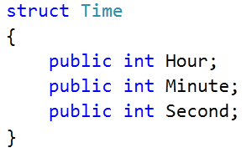



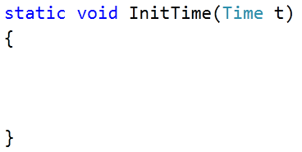

Value-Type Example
10
07
30
00
10
00
07
00
30

Slide 3
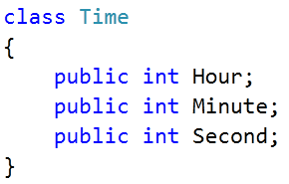

Reference-Type Example
1500
00
1500
10
00
07
00
30
1500

